Slide 1


Introduction to Pivotal Cloud Foundry
Notes:
Resting slide on screen before you begin presenting.

Slide 2
PCF 101 Agenda
PCF Overview
Orgs, Spaces, Users and Quota
CF CLI, Apps Manager, and Cloud Controller API
Buildpacks
Services
Logging
Demo

Slide 3
PCF Overview
The Cloud-Native Platform

Slide 4
What is Cloud foundry
“Cloud Foundry is an open source cloud agnostic platform as a service (PaaS) on which developers can build, deploy, run and scale applications.”

Slide 5
The Cloud Platform Evolution
Business Value, Agility & Cost Savings
Traditional IT
IaaS
PaaS
Applications
Applications
You Manage
Applications
Data
Data
Data
You Manage
Runtime
Runtime
Runtime
Middleware
Middleware
Middleware
You Manage
O/S
O/S
O/S
Pivotal CF
+
Virtualization
Virtualization
Virtualization
Servers
Servers
IaaS
Servers
IaaS
Storage
Storage
Storage
Networking
Networking
Networking
Level of Abstraction
Notes:
Intro: And this is what PCF tries to solve, removing the operational burden by elevating the level of abstraction.
1 – Before Virtualization companies needed to handle all layers of the technology stack, and with the onset of virtualization, elevating the level of abstraction up to VMs companies optimized costs and become more agile
2 – But it was still not enough for Devs (what can they do with VMs?). The logical evolution is to raise again the level of abstraction with a Platform that can automate and orchestrate all pieces underneath
3 – In a Cloud Native Platform like PCF you focus on managing apps and data services (if external), enabling your teams to focus on generating biz value.
Transition: All this leads to become more agile and reduce costs even further.
--
PCF solves the last mile problem: the abstracted pool of machines that still had to be managed and configured and setup are now orchestrated in a reliable, compliant manner so that the developers can focus on apps, and the bootstrapping of all other external dependencies is automatic and effortless
A structured Platform that provides the opinion and the governance to deploy directly to prod safely, with a level of abstraction that handles the orchestration of all pieces underneath. Opinionated in the way it builds, packages and runs your applications
But giving you full flexibility and choice on the language, framework, backing services and cloud you want to use
Enables you to use the right tool for the right problem at different levels

Slide 6
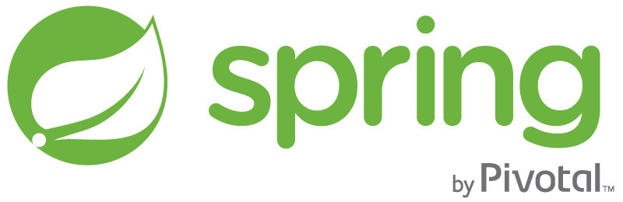


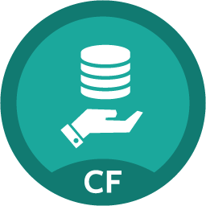
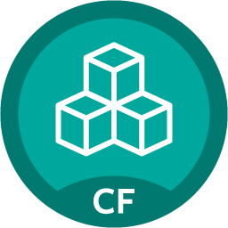
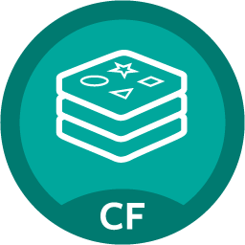
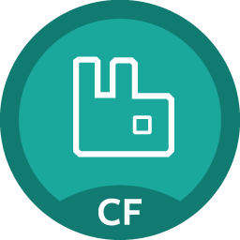

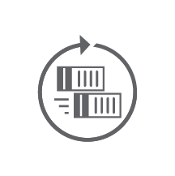
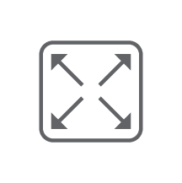
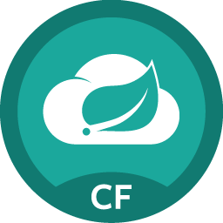
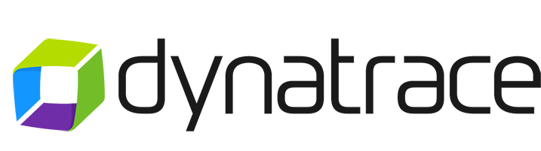
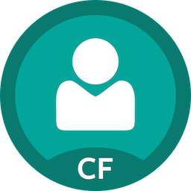


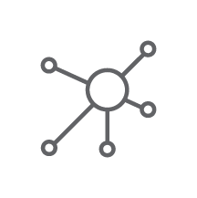
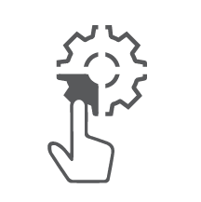
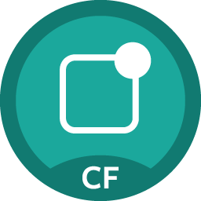




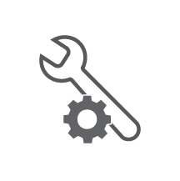
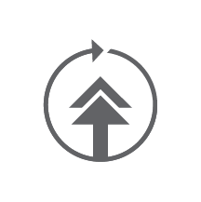


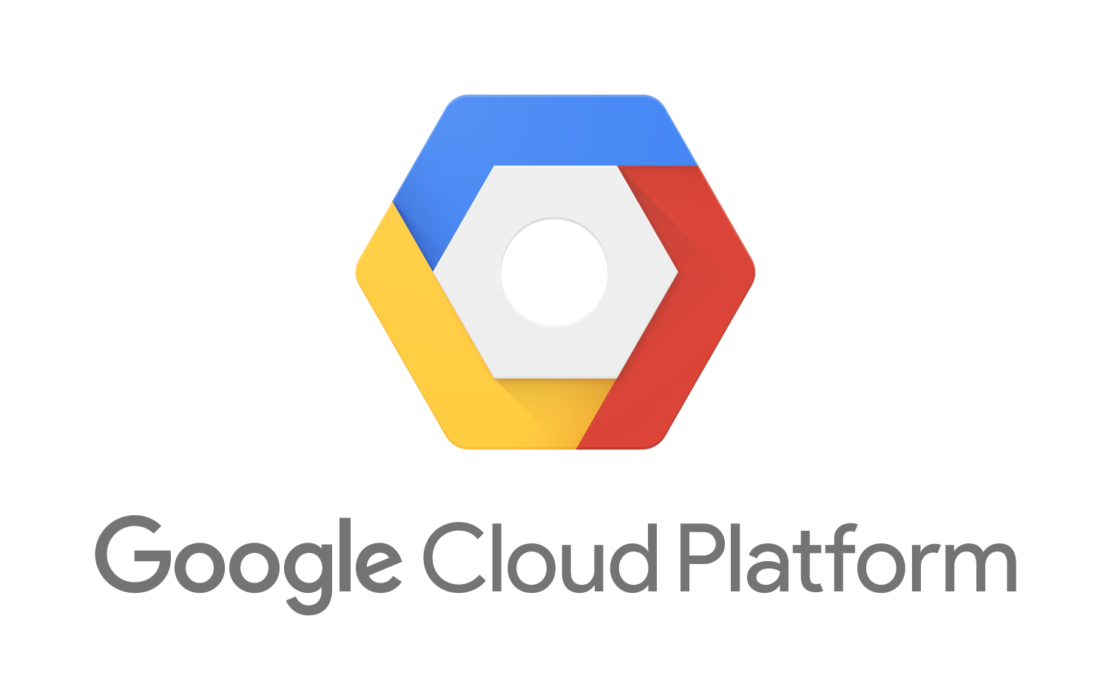
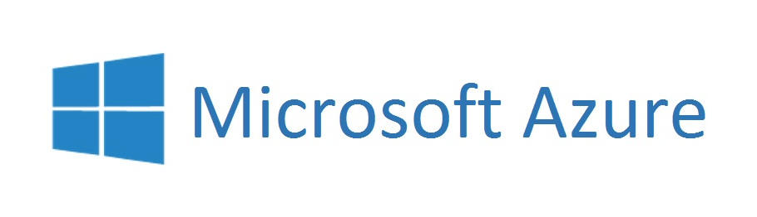
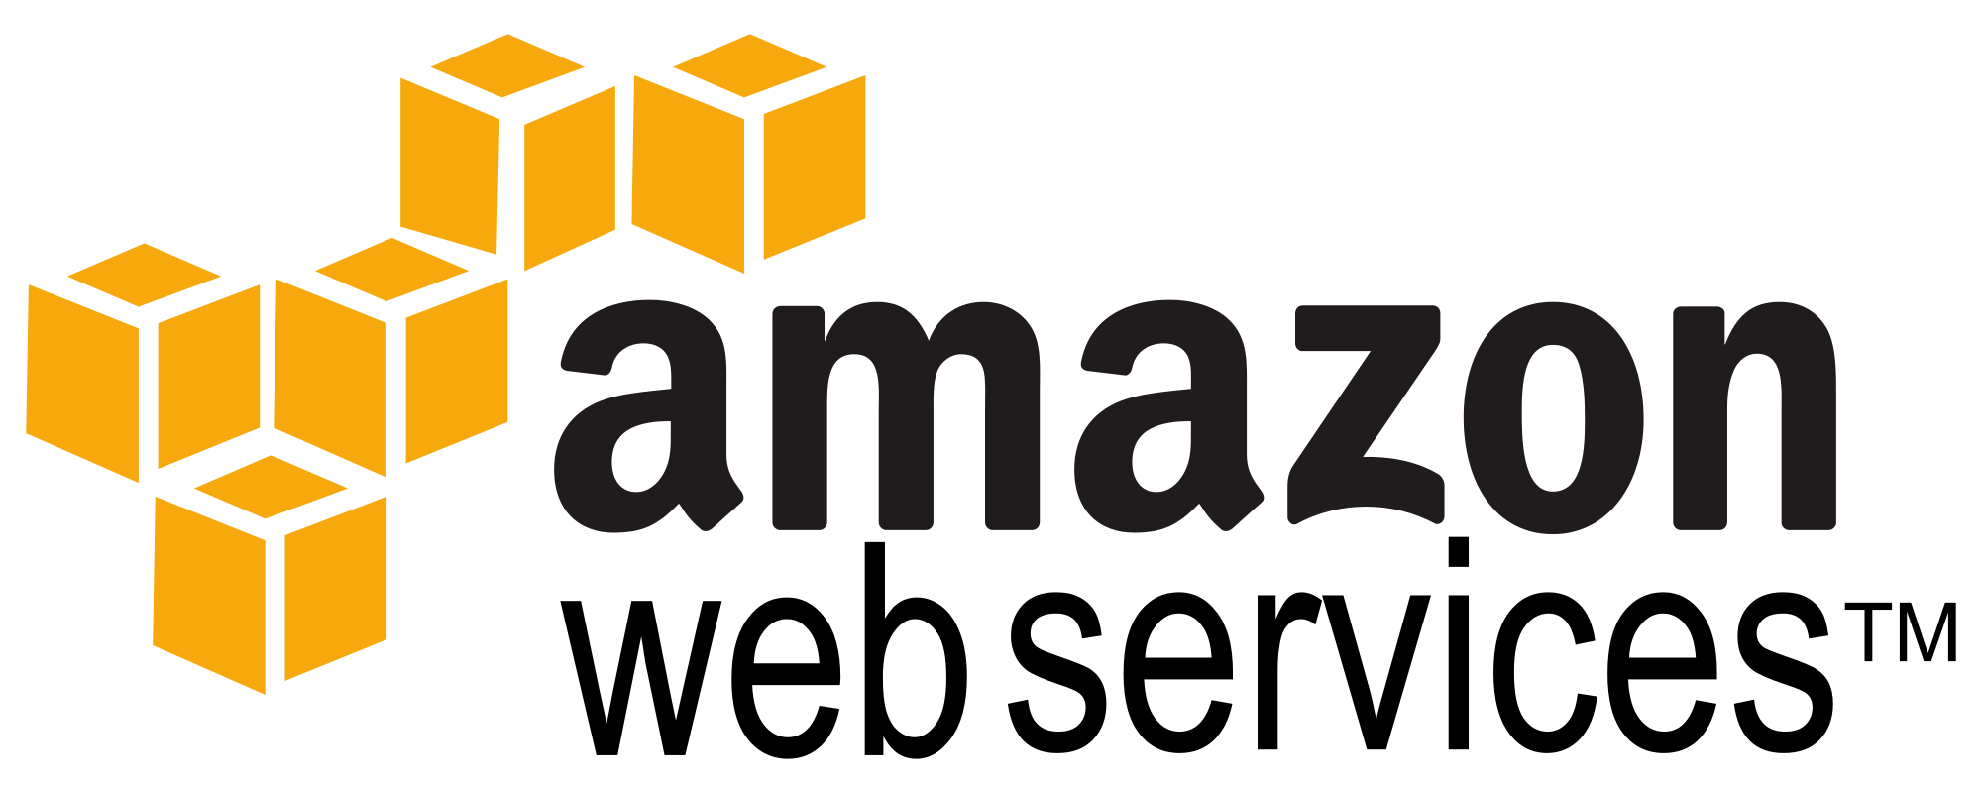

Applications/APIs/Microservices
BOSH Managed
Services
Brokered Services
MySQL
MySQL
Pre-packaged container deployed and managed by platform
PIVOTAL
Gemfire
Gemfire
Java | .NET | Ruby | Node.js | Python | PHP | Go
…
Redis
Redis
PCF Elastic Runtime
PIVOTAL
RabbitMQ
RabbitMQ
Automated, Polyglot Build/Package/ Deploy
Spring Cloud
Services
Container Scheduling
Elastic (Auto)Scale
PCF Tools
Single Sign On
PARTNERED
z
• Apps Manager UI
(App Admin UI)
• CLI
• REST APIs
• PCF Metrics
Dashboard
Integrated Logging/Metrics*
Dynamic Routing & Extensible Route Services
Dev + Ops Role-Based Self-Service Access
Mobile Push Notifications
…
Self-Healing &
High Availability*
Zero Downtime Upgrades & Patches*
PARTNER
…
Security*
Oracle DB
Dingo PostgreSQL
…
MS SQL Server
USER PROVIDED
Infrastructure Automation
(BOSH)
Active MQ
Ops Manager UI
(Cloud Admin UI)
Infrastructure Agnostic Software Packaging
Multi-Cloud Orchestration of Infrastructure Provisioning
IBM DB/2
Distributed Software Configuration and Health/Lifecycle Management
…
Infrastructure
*Application & Platform

Slide 7
Orgs, Spaces, Users, and Quota

Slide 8
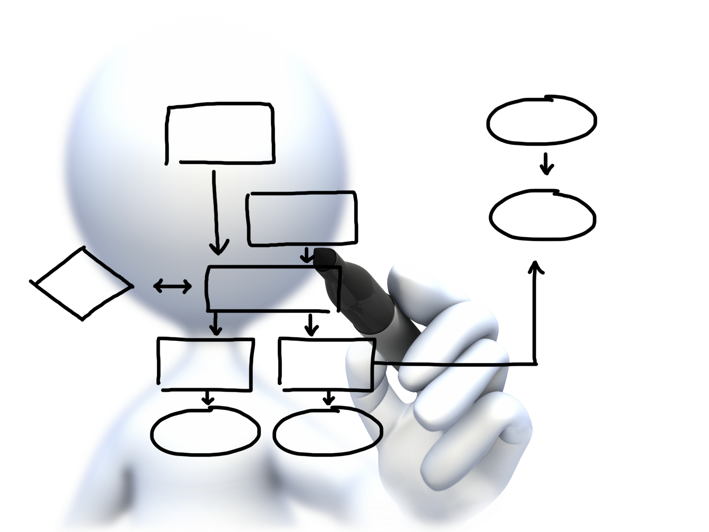
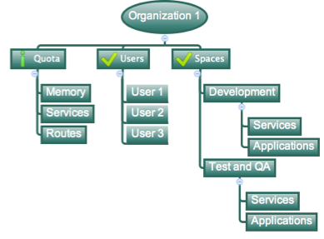
Orgs, Spaces, Users, and Quotas
Cloud Foundry Installation

Slide 9
Organizations
Top-most administrative unit
Logical division division within a Pivotal Cloud Foundry Install / Foundation
Typically a company, department, application suite or large project
Each organization has its own users and assigned quota
User permissions / Roles are specified per space within an organization
Sub-divided into spaces

Slide 10
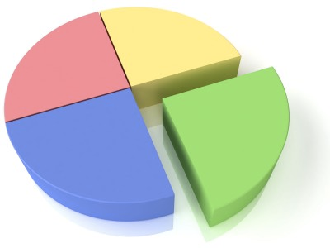
Quotas and Plans
Different quota limits (e.g. small, enterprise, default, runaway) can be assigned per Organization
Quotas defines
Total Memory
Total # of services
Total # of Routes
Sub-divided into spaces

Slide 11

Spaces
Logical sub-division within an organization
Users authorized at an organization level can have different roles per space
Services and Applications are created / target per Space
Same service name can have different meaning per space

Slide 12
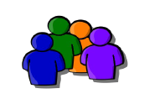
Users and Roles
Users are members of an organization
Usually they are operators or developers (not application end users)
Users are sent an email invite and asked to create an account
Users have specific organization and space roles
Organization roles grant permissions in an organization
Space roles grant permissions in a particular space
A combination defines the user’s overall permissions

Slide 13
CF CLI, Apps Manager, Cloud Controller API

Slide 14
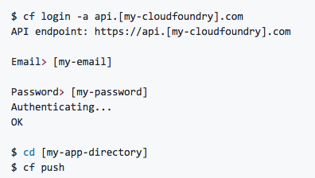
CF CLI
Cross platform command line tool to interact with a cloud foundry foundation.
Used to:
Deploy
Scale
Monitor
Space/Org management
Much More!
https://github.com/cloudfoundry/cli

Slide 15
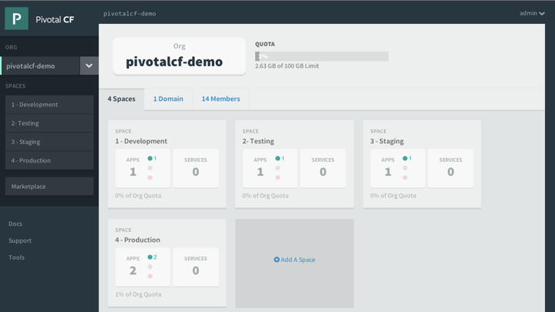
Apps Manager
Manage Organizations, users, applications and Spaces
Monitor applications logs, services and routes
Access Service Marketplace, create services and bind to applications

Slide 16
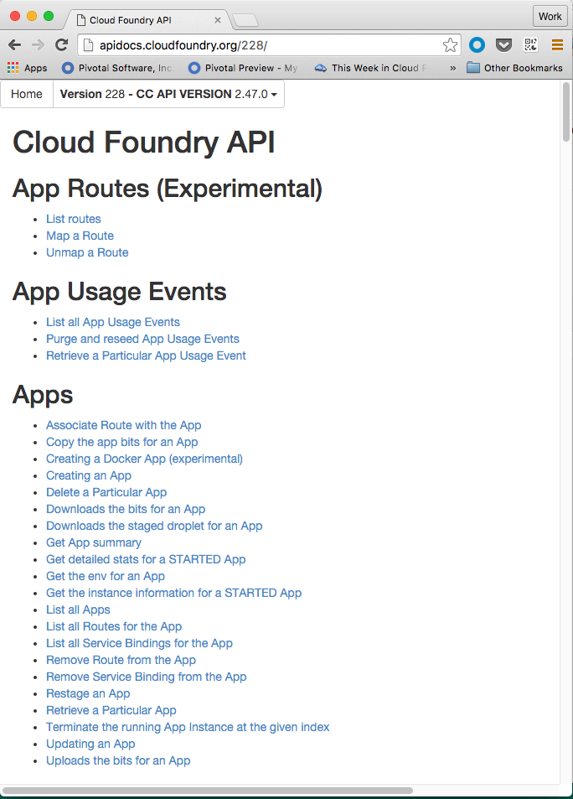
Cloud Controller API
Cloud Controller component of Elastic Runtime manages all Cloud Foundry APIs
CF CLI and other clients like Apps Manager directly call this API
Before accessing the CC API, you must get an access token from the ERS component called User Account and Authentication (UAA) server
http://apidocs.cloudfoundry.org

Slide 17
Buildpacks

Slide 18
Buildpacks
“Buildpacks provide framework and runtime support for your applications. Buildpacks examine user-provided artifacts to determine what dependencies to download and how to configure applications to communicate with bound services.”

Slide 19
PCF System Buildpacks
Name | Supported Languages, Frameworks, and Technologies
Binary | N/A
Go | Go
Java | Grails, Play, Spring, or any other JVM based language or framework
.NET Core | .NET Core
Node.js | Node or JavaScript
PHP | Cake, Symfony, Zend, Nginx or HTTPD
Python | Django or Flask
Ruby | Ruby, JRuby, Rack, Rails, or Sinatra
Staticfile | HTML, CSS, JavaScript, or Nginx

Slide 20
Services

Slide 21
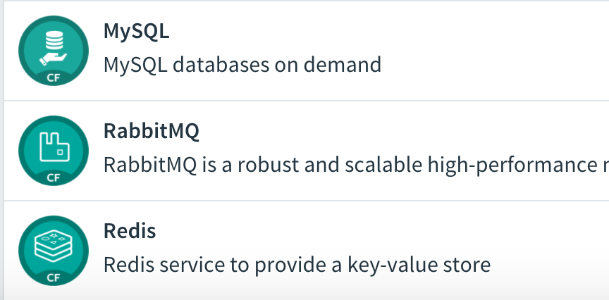
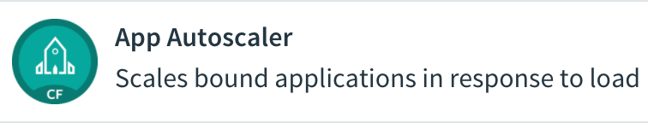
What is a Service?
Allows resources to be easily provisioned on-demand
Typically middleware and other “components” necessary for applications
Can be a persistent, stateful layer
Applications consume service details via environment variables

Slide 22
Types Of Services
PCF Services
MySQL
PIVOTAL
Pivotal Managed – Fully integrated life cycle management with Cloud Foundry
Partner Managed – Same as above but supported by a Pivotal Partner
User-Provided – Create and managed external to the platform
Gemfire
…
Redis
RabbitMQ
PARTNERED
…
Oracle DB
MS SQL Server
USER PROVIDED
Active MQ
IBM DB/2
…

Slide 23
Managed Service
Integrated with Cloud Foundry by implementing a documented API for which the cloud controller is the client
Requires a Service Broker component which will implement the required API
Create - Fetch Catalog
Bind - Delete
Unbind

Slide 24
User Provided Service instances
User-provided service instances are service instances which have been provisioned outside of Cloud Foundry
Behave like other service instances once created
Familiar commands (‘create-service’) provide service instance configuration (including credentials) to applications, eliminating the need to hard code service instance endpoints
Example: An Oracle database managed outside of, and unknown to Cloud Foundry

Slide 25
Logging

Slide 26
Logging
Cloud foundry will capture application logs that are written to standard out.
App Developers can view logs via the CF CLI, the apps manager UI or a third party tool like ELK stack or Splunk

Slide 27
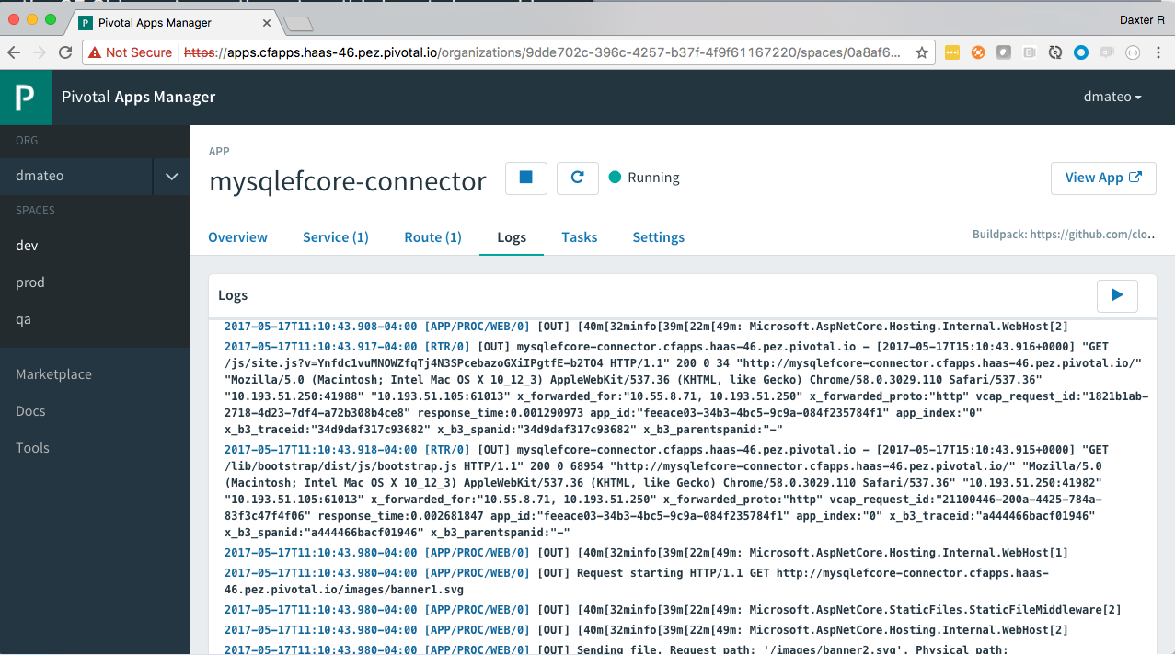
Logging – Apps Manager

Slide 28
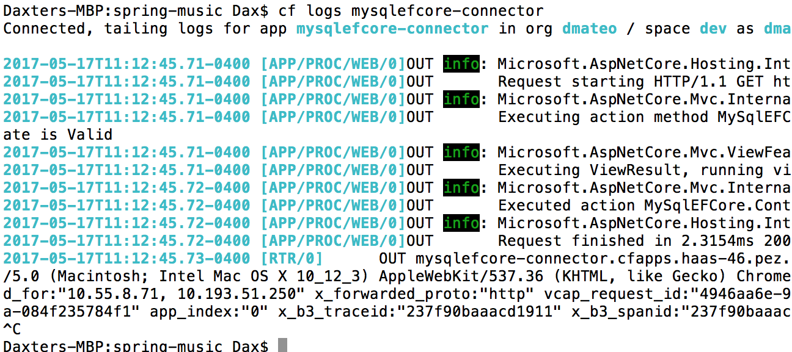
Logging - CLI

Slide 29
Domains and Routes

Slide 30
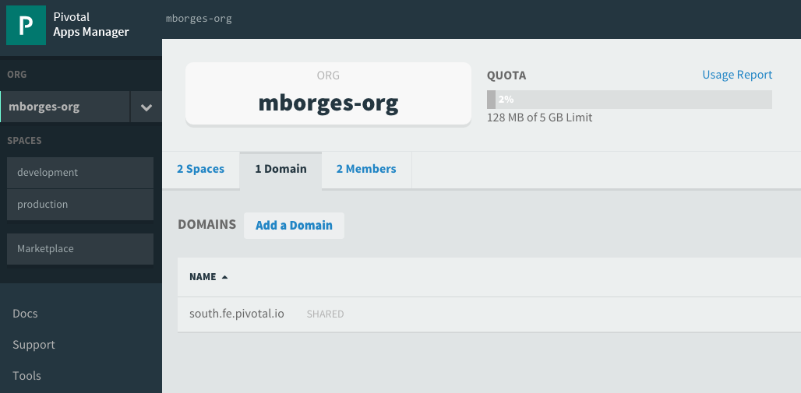
Domains
Domains provide a namespace from which to create routes
Each Cloud Foundry installation has a default apps domain
Platform operators can add additional domains as they see fit
Domains can be shared or private in regards to PCF organizations

Slide 31
Routes
The URL used to reach an application hosted on Cloud Foundry is accessed by it’s route + domain
http://my-app-route-here.my-app-domain-here
Many apps can be mapped to a single route resulting in load balanced requests
Routes belong to a space
Application can have multiple routes

Slide 32
Hands-on

